Slide 1
Case Studies
Presented by Ninja Stars
Team Leader : Wed Aljuaid
Team Member : Ibtisam Alshammari, Mohammed Alomari, Mohammed Mostanteq, Myamin Abushokan

Slide 2
Table of contents
01
02
03
First Case Study
Second Case Study
Third Case study
Gender equality plan
COVID-19
Bonus plan

Slide 3
Case 1
Gender Equality Plan

Slide 4
Case 1
Total Employees for each gender:
The total number of male employees in the company is much greater than female employees by a difference of 59,922 employees

Slide 5
Gaps between genders:
Looking at the chart above almost all departments have gaps between genders. HR, research, marketing, customer service, sales, and development have the highest gaps between males and females. To achieve gender quality policy, we need to hire 96, 102, 93, 107, 239, and 395 women every year during the following five years to the mentioned departments respectively. We also need to hire 77 females in Finance, 237 in Production, and 81 in Quality management.

Slide 6
Average salary for each gender:
The average salary for males and females are almost equal for all departments.

Slide 7
Case 2
COVID-19

Slide 8
Case 2
The strategy that we will follow in this case is:
Decrese the current salaries of employees by 20%.
Decrese the current salaries of managers by 10%.
Lay off 406 employees that have experience less than 1 year and their ages equal or greater than 49 years old.
We will give all employees including managers bounce of 219 dollars.
We will give that who laid off 2754 dollars as gift.

Slide 9
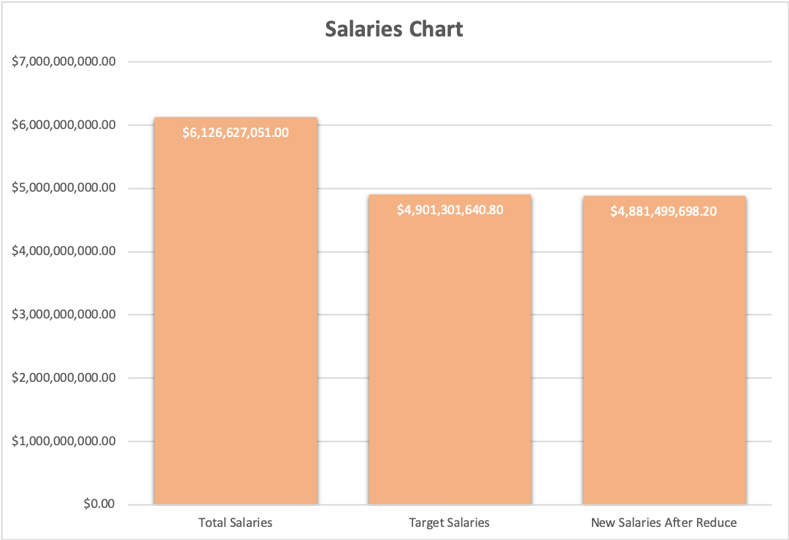
Case 2
Total Salaries | $6,126,627,051.00
Reduced Salaries | $4,901,301,640.80
New Salaries After Reduce | $4,881,499,698.20
Surplus | $19,801,942.60
Number Of Retired Employees | 406
Number Of Current Employees | 101195

Slide 10
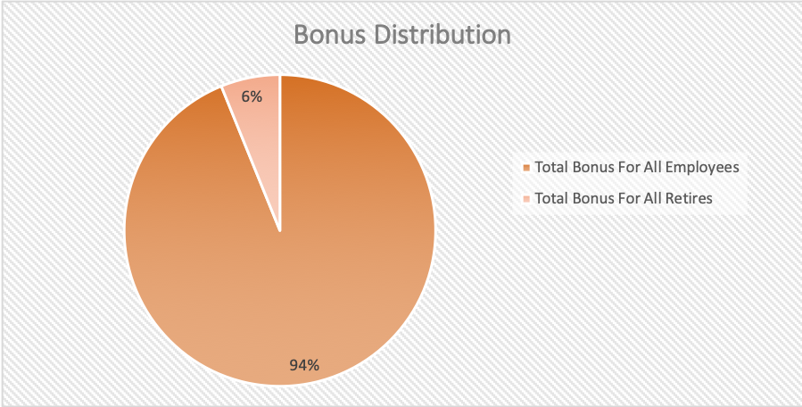
Case 2
Bonus For Every Employees | $219.73
Bonus For Newly Retired Employees | $2,754.02
Total Bonus For All Employees | $18,683,811.25
Total Bonus For All Retires | $1,118,131.35

Slide 11
Case 2
We choose this strategy for managers because they have core rules in the company and decreasing their salaries will not have big effect in company's budget. And we think the layoff will affect the company employee’s moral, so we decided to give retired employees money as gift and show them that we care about our members or the company will have bad reptation and lose more than just money.

Slide 12
Case 3
Bonus Plan

Slide 13
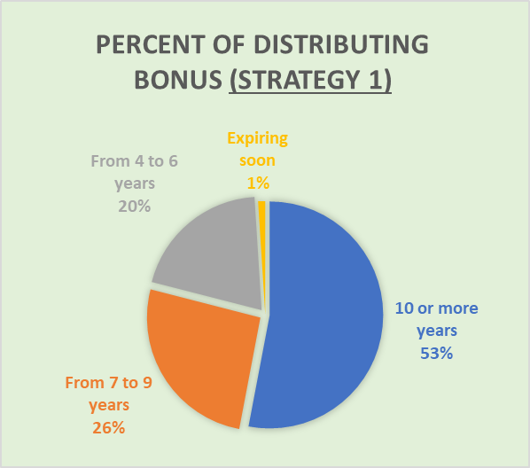
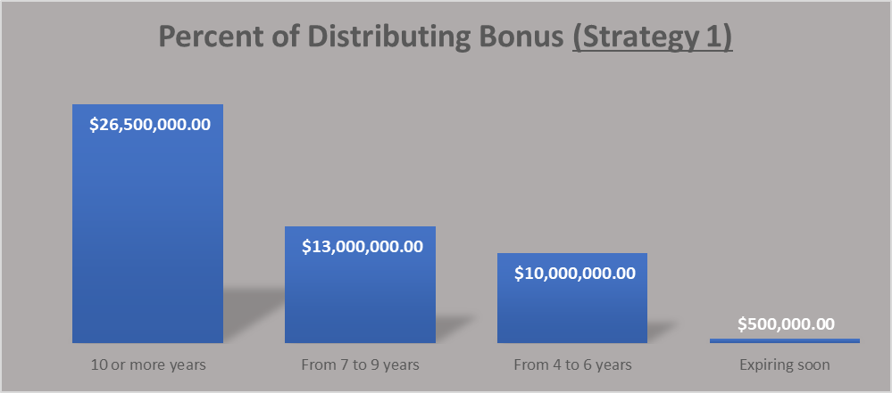
Case 3: Bonus Distribution Plan
First Strategy:
Based on years of service & expiring contracts
Equal distribution within each category

Slide 14
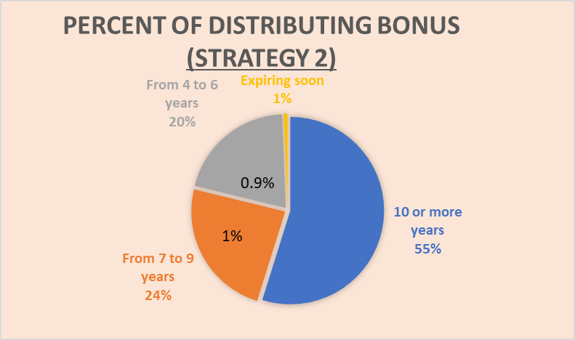
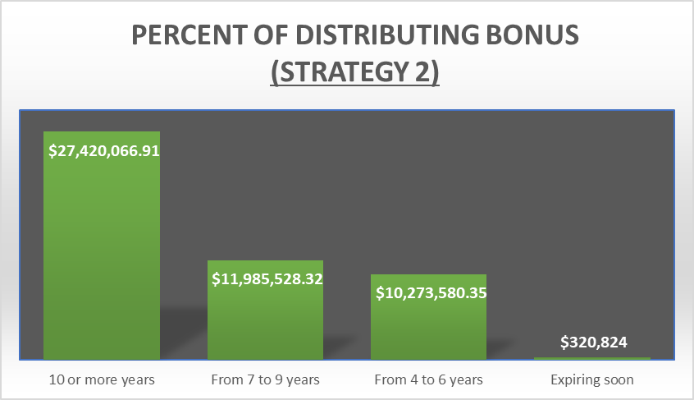
Case 3: Bonus Distribution Plan
Second Strategy:
Based on years of service & expiring contracts
Based on amount of salary for each employee within each category
1.1%

Slide 15
Thank you for watching
Does anyone have any questions?

